Slide 1
COLLECTIONS AND GENERICS

Slide 2
Objective
Revisiting Collections
Collection Hierarchy, Collection Interfaces and Classes
How to iterate over collection class objects?
Understand the concept of generics
Understand generic collection classes
How to work with generic classes and functions
How to compare collections of business objects?

Slide 3
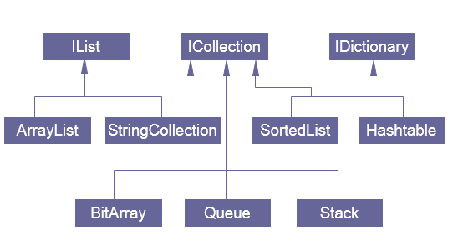
Collections Hierarchy

Slide 4
System.Collections: Interfaces
Core Interface | Description
ICollection | Defines size, enumerators and synchronization methods for all collections.
IComparer | Exposes a method that compares two objects.
IDictionary | Represents a collection of key-and-value pairs.
IDictionaryEnumerator | Enumerates the elements of a dictionary.
IEnumerable | Exposes the enumerator, which supports a simple iteration over a collection.
IEnumerator | Supports a simple iteration over a collection.
IHashCodeProvider | Supplies a hash code for an object, using a custom hash function.
IList | Represents a collection of objects that can be individually accessed by index.
Notes:
The table shows the Interfaces available in the System.Collections namespaces. These interfaces are implemented by various collection classes which we will see in a diagram a little later.

Slide 5
System.Collections: Implementations
ICollection | IList | IDictionary
BitArray | ArrayList | Hashtable
Stack | StringCollection | SortedList
 | Queue
Notes:
This table shows some of the basic and frequently used collection classes which implements the Collection Interfaces.

Slide 6
Iteration over Collection Class Objects
More or less, every collection class object, can be iterated over using either all or some of the techniques mentioned below
Iteration using for loop
Iteration using foreach loop
Iteration using IEnumerator

Slide 7
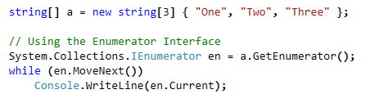
Enumeration over Collection of Items
C# provides us with Enumerators to allow us enumerate through the elements within the objects
We need to use interface IEnumerate to enumerate through the elements of any collection class object
Notes:
Enumerators can be used to read the data in the collection, but they cannot be used to modify the underlying collection
Initially, the enumerator is positioned before the first element in the collection.
The Reset method also brings the enumerator back to this position.
At this position, the Current property is undefined. Therefore, you must call the MoveNext method to advance the enumerator to the first element of the collection before reading the value of Current.
Current returns the same object until either MoveNext or Reset is called. MoveNext sets Current to the next element.
If MoveNext passes the end of the collection, the enumerator is positioned after the last element in the collection and MoveNext returns false. When the enumerator is at this position, subsequent calls to MoveNext also return false. If the last call to MoveNext returns false, Current is undefined. To set Current to the first element of the collection again, you can call Reset followed by MoveNext.
An enumerator remains valid as long as the collection remains unchanged. If changes are made to the collection, such as adding, modifying, or deleting elements, the enumerator is irrecoverably invalidated and its behavior is undefined.
The enumerator does not have exclusive access to the collection; therefore, enumerating through a collection is intrinsically not a thread-safe procedure. To guarantee thread safety during enumeration, you can lock the collection during the entire enumeration. To allow the collection to be accessed by multiple threads for reading and writing, you must implement your own synchronization.

Slide 8
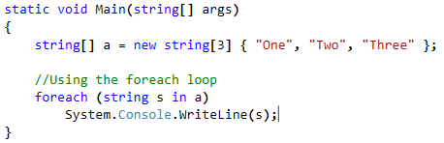
foreach loop and Enumerator
The foreach statement of the C# language hides the complexity of the enumerators.
Therefore, using foreach is recommended, instead of directly manipulating the enumerator.

Slide 9

IEnumerable interface and GetEnumerator method
GetEnumerator method belongs to IEnumerable interface
Returns an enumerator that iterates through a collection.
Return Value
Type: System.Collections.IEnumerator An IEnumerator object that can be used to iterate through the collection.

Slide 10
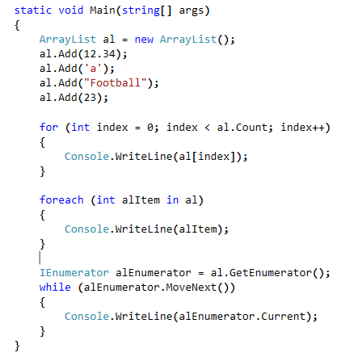
Iterating ArrayList Elements using for, foreach loop and Enumerator
Iteration using for loop
Iteration using foreach loop
Iteration using enumerator directly

Slide 11
The Classes and Interfaces of Generics.
Queue<T>
IEnumerable<T>
extends
implements
HashSet<T>
ICollection<T>
Interface
Class
Stack<T>
IDictionary<TK,TV>
IList<T>
Dictionary<TK,TV>
LinkedList<T>
List<T>
SortedDictionary<TK,TV>

Slide 12
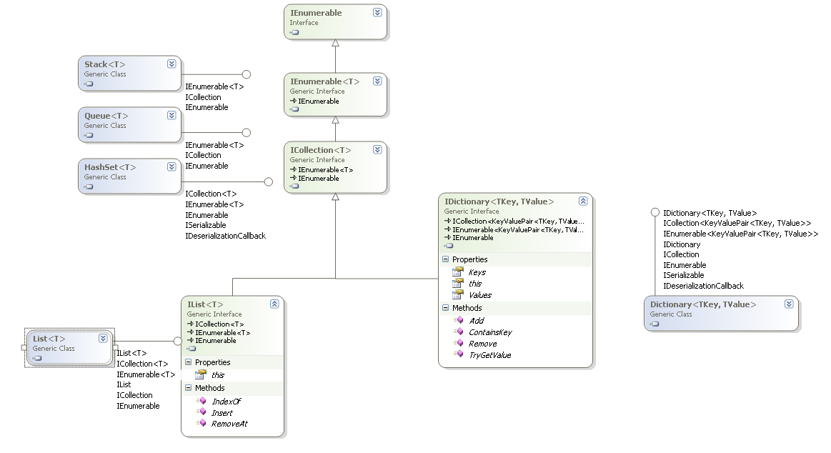
Complete Hierarchy

Slide 13
Classes under Generics
Class | Description
List<T> | A dynamic array. Provides functionality similar to that found in the non-generic ArrayList class.
Dictionary<TK, TV> | Stores key/value pairs. Provides functionality similar to that found in the non-generic Hashtable class.
HashSet<T> | Represents a set of values.
LinkedList<T> | Stores elements in a doubly linked list.
Queue<T> | A first-in, first-out list. Provides functionality similar to that found in the non-generic Queue class.
SortedDictionary<TK, TV> | A sorted list of key/value pairs.
SortedList<TK, TV> | A sorted list of key/value pairs. Provides functionality similar to that found in the non-generic SortedList class.
Stack<T> | A first-in, last-out list. Provides functionality similar to that found in the non-generic Stack class.

Slide 14
Interfaces of Generics
Interfaces | Decription
IEnumerable<T> | Exposes the enumerator, which supports a simple iteration over a collection of a specified type.
ICollection<T> | Defines methods to manipulate generic collections
IList<T> | Represents a collection of objects that can be individually accessed by index
IEnumerator<T> | Supports a simple iteration over a generic collection
IComparer<T> | Defines a method that a type implements to compare two objects
IDictionary<TK,TV> | Represents a generic collection of key/value pairs.
IEqualityComparer<T> | Defines methods to support the comparison of objects for equality

Slide 15
Generic vs. Non Generic
Non Generic stores the data as Object
Not type safe
Available in v1.0 and v1.1 and later versions
Generic are type safe way of storing the objects as Data structures
Available since v2.0
Easy way of storing objects.
Example of Non Generic Version.

Slide 16
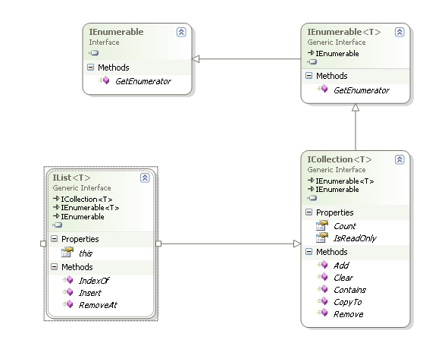
IList<T>
Represents a collection of objects that can be individually accessed by index.
Functions
Insert
RemoveAt
Notes:
The IList is the Descendent of ICollection which is the base interface for all generic Lists of .NET.
Insert method inserts the element at the specified Index.
RemoveAt removes an Element from the specified Index.
Supports all the methods of ICollection like Add, Clear, Remove…….

Slide 17
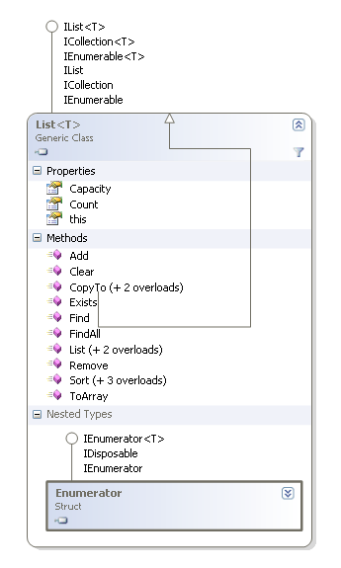
The List<T> Design
Provides a Generic Dynamic Array kind of Data storage in it.
Stores the data as First In Last Out.
Simplest form of storing the data where we can modify the structure at any point of time.
Notes:
Some of the Important Methods:
Add->Adds the Element to the Last of the list.
Remove->Removes the Specified Element from the List.
Find->Takes a Delegate called Predicate that evaluates an Expression on the Find Criteria and returns the found Element else returns null
ToArray->Coverts the List to a fixed size Array.
Important Properties:
Capacity->Initiailizes the size of the list
Count->Current size of the List, if new element is added, the count increases.
NOTE: If the capacity has reached while adding, the Capacity automatically increments by the no of elements you have added to the List.

Slide 18
List<T> Usage
Lists are Dynamic Array.
Element is added to the Last of the list.
The Count gives the number of elements within the List.
List Container
…..
Position 0
Position 1
Position 2
Position n -1

Slide 19
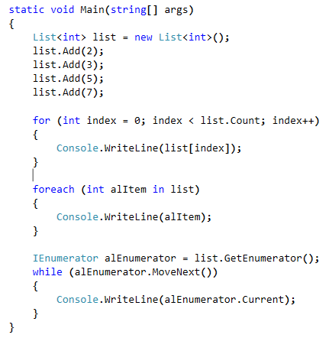
Example:
Iteration using for loop
Iteration using foreach loop
Iteration using enumerator directly
Notes:
Faculty Note: Explain the example

Slide 20
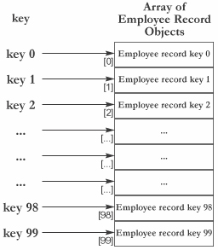
Dictionary<TK,TV>
Stores the data as Key-Value Pairs
Provides a mapping from a set of keys to a set of values.
Data accessed by the Keys.
Dictionaries are Dynamic, grows if needed.
Notes:
Dictionaries represent a sophisticated data structure that allows you to access an element based on a
key. Dictionaries are also known as hash tables or maps. The main feature of dictionaries is fast lookup
based on keys. You can also add and remove items freely, a bit like a List < T > , but without the
performance overhead of having to shift subsequent items in memory.
NOTE: keys are unique to the Collection, value can be same. If u want to access the elements, you could access it by the Key name instead of Index that is used in List<T>. It is also performance based if you want to store a pairs of data in which one section needs to be unique.

Slide 21
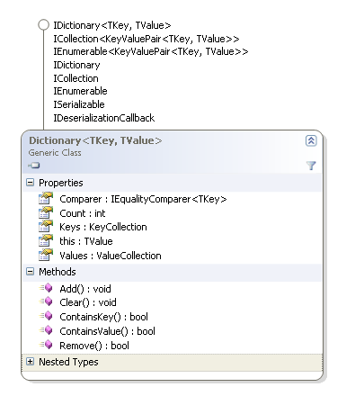
The Class Structure
Notes:
The Dictionary class has methods to Add, Remove, Check for Key, Check for Value.
The Properties:
Keys gets total Keys associated within the Collection.
Values gets the Complete Collection of Values associated within the Collection
The Methods:
ContainsKey returns True if the Key already exists else returns False
ContainsValue returns True if the Value already exists else returns False.

Slide 22
Important Members
Method | Description
Add(TK k, TV v) | Adds the key/value pair specified by k and v to the dictionary. If the k is already in the dictionary, then its value is unchanged and an ArgumentException is thrown.
ContainsKey(TK k) | Returns true if k is a key in the invoking dictionary. Returns false otherwise.
ContainsValue(TV v) | Returns true if v is a value in the invoking dictionary. Returns false otherwise.
GetEnumerator( ) | Returns an enumerator for the invoking dictionary.
Remove(TK k) | Removes k from the dictionary. Returns true if successful. Returns false if k was not in the dictionary.

Slide 23
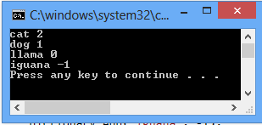
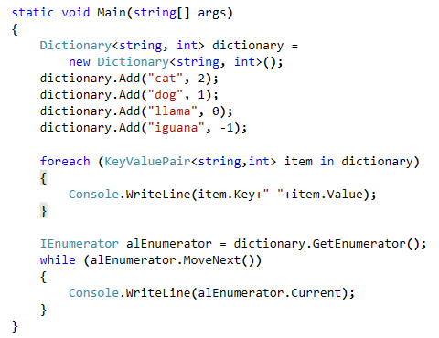
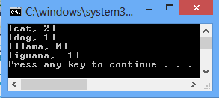
Example:
Iteration using foreach loop
Iteration using enumerator directly
Since each element of a collection based on IDictionary<TKey, TValue> is a key/value pair, the element type is not the type of the key or the type of the value. Instead, the element type is KeyValuePair<TKey, TValue>
Notes:
Faculty Note:
Explain the example.
Explain KeyValuePair<TK,TV> class and it’s properties (Key and Value)

Slide 24
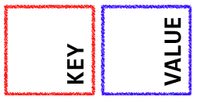
KeyValuePair<TK,TV>
When Dictionary, or any object that implements IDictionary, is used in a foreach-loop, it returns an enumeration. In the case of Dictionary, this enumeration is in the form of KeyValuePair values.
KeyValuePair<TK,TV>: Defines a key/value pair that can be set or retrieved.
Type Parameters:
Tkey: The type of the key
TValue: The type of the value
Important Properties:
Key: Gets the key in the key/value pair
Value: Gets the value in the key/value pair

Slide 25
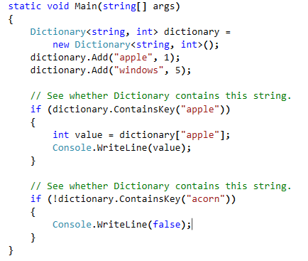
ContainsKey method of Dictionary
you can check to see if a given item is present in a Dictionary, with ContainsKey method. It returns true if the key was found.
Just pass the key in the method.

Slide 26
HashSet<T>
Provides unordered list of Distinct Items.
A set is a collection that contains no duplicate elements, and whose elements are in no particular order.
Use set only when you don’t want Duplicate entries into your Collection.
HashSet is almost the same as your Algebra’s set functionality.
It provides a simple syntax for taking the union of elements in a set. This is performed in its constructor
Notes:
HashSet<T> implements a set in which all elements are unique. In other words, duplicates are not allowed. The order of the elements is not
specified. HashSet<T> defines a full complement of set operations, such as intersection, union, and symmetric difference. This makes HashSet<T> the perfect choice for working with sets of objects. HashSet<T> is a dynamic collection that grows as needed to
accommodate the elements it must store.

Slide 27
Important Members
Method | Description
Add(T element) | Adds the specified element to a set. Returns false if element already exists.
UnionWith | Modifies the current HashSet<T> object to contain all elements that are present in itself, the specified collection, or both.
IntersectWith | Changes the set to include only elements that are part of both the collection that is passed and the set
RemoveWhere | This method removes all elements on the condition that it match. The Condition is given as function thro a Delegate object called Predicate.
ExceptWith | Receives a collection as argument and removes all the elements from this collection from the set.

Slide 28
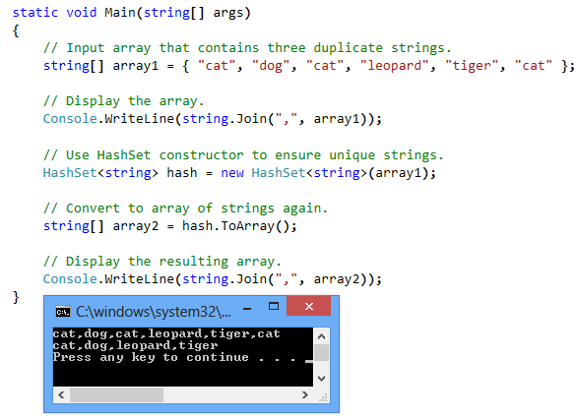
Example:
the input array contains six strings (four unique). The string "cat" is repeated three times. This may not be desirable to some programs and algorithms. The HashSet constructor eliminates the non-unique elements.

Slide 29
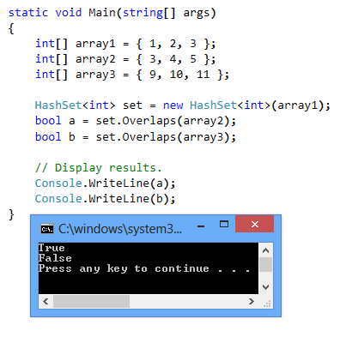
HashSet: Overlaps method
This method returns true or false. It tests to see if any of the HashSet's elements are contained in the IEnumerable argument's elements. Only one equal element is required.
The element 3 is in the HashSet. This means Overlaps returns true for array2, but false for array3.

Slide 30
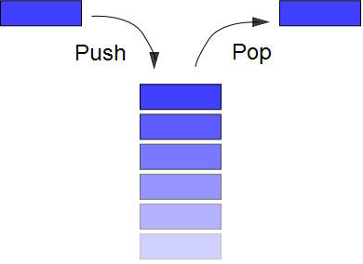
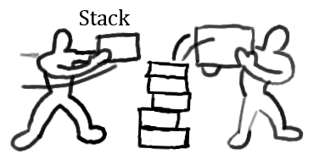
Stack<T>
Stack<T>.
Stores the data as First In- Last Out manner.
Notes:
Stack: To visualize a stack, imagine a stack of plates on a table. The first plate put down is the last one to be picked up. The stack is one of the most important data structures in computing. It is frequently used in system software, compilers, and AI-based backtracking routines, to name just a few.
Reference:
http://msdn.microsoft.com/en-us/library/system.collections.generic(v=VS.90).aspx
EBook:
Professional C#, Chapter 10.

Slide 31
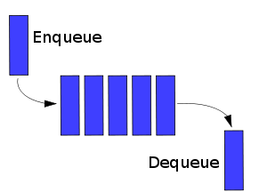
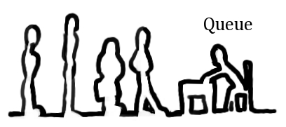
Queue<T>
Queue<T>.
Stores the Data as First-In- First Out manner.
Notes:
Queue:That is, the first item put in a queue is the first item retrieved. Queues are common in real life. For example, lines at a bank or fast-food restaurant are queues. In programming, queues are used to hold such things as the currently executing processes in the system, a list of pending database transactions, or data packets received over the Internet. They are also often used in simulations.

Slide 32

IComparable
Implement this interface for comparing the current object in a collection with another object in the same collection
This provides an ability to compare 2 objects in a certain condition.
Using its method, we could provide the functionality of sorting of our Data in a certain Condition.
You can make any class work with IList’s built-in Sort Function by having it implement IComparable.
Notes:
Classes that implement IList uses IComparable to sort the data by calling Sort Method.
All Built In types of .NET implement IComparable.
Sort uses the object’s CompareTo method to compare it with other objects and uses its return value to determine which should come first.

Slide 33
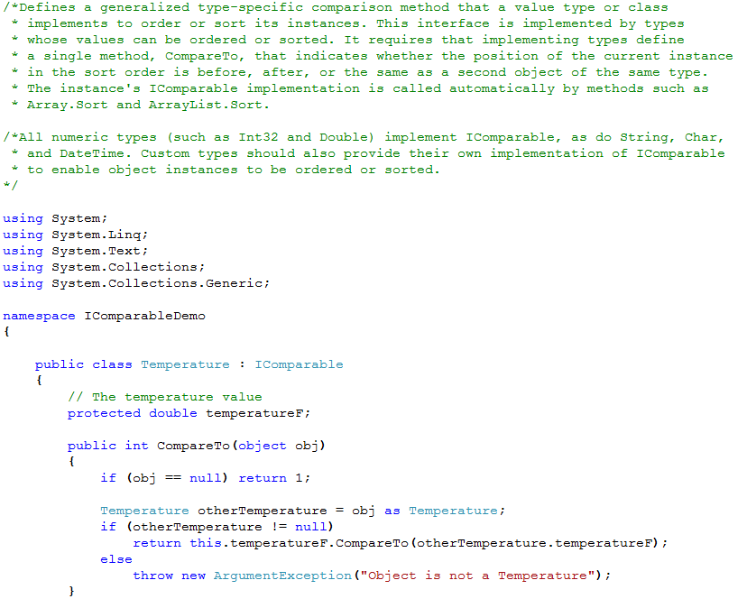
IComparable Interface Example

Slide 34
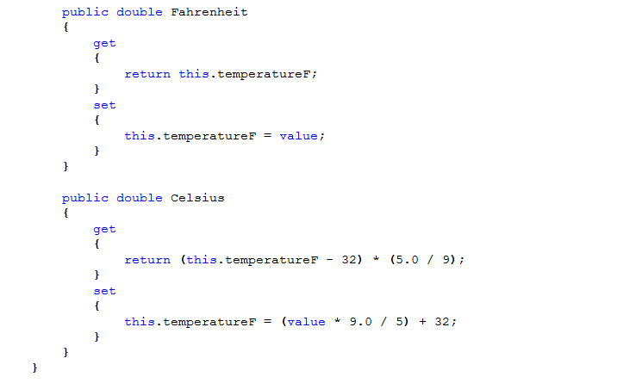
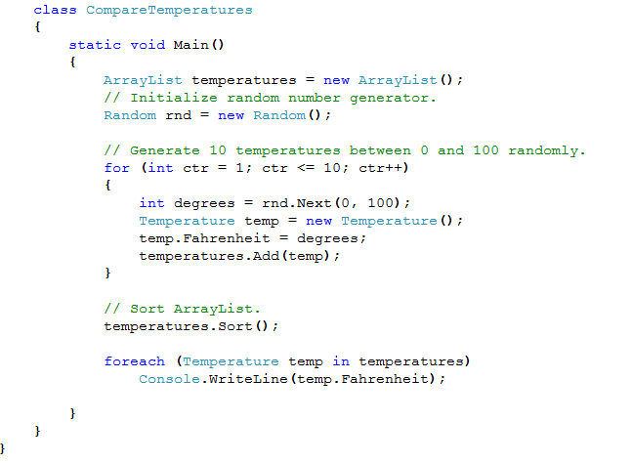
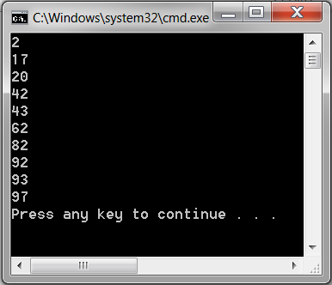
IComparable Interface Example

Slide 35
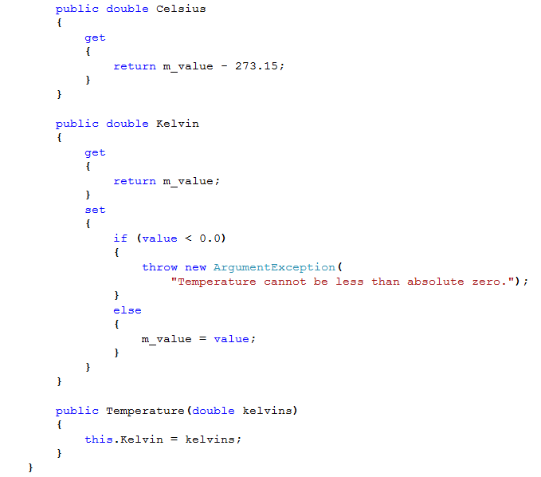
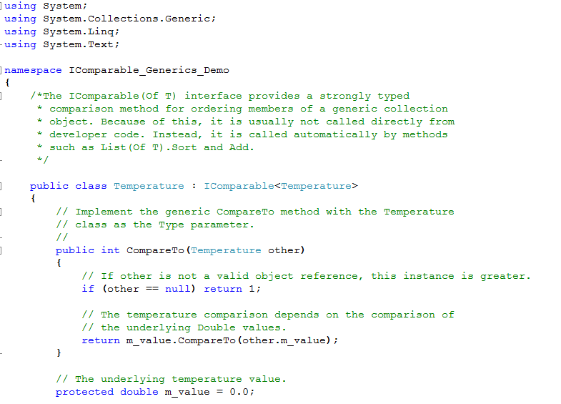
IComparable<T> Interface Example

Slide 36
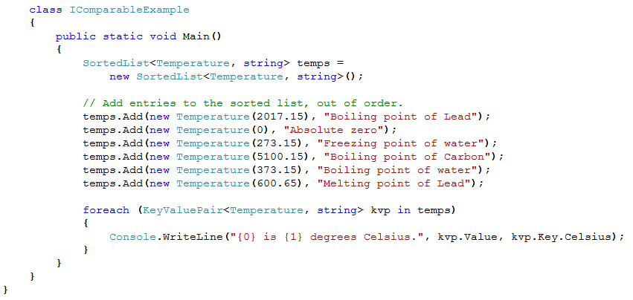
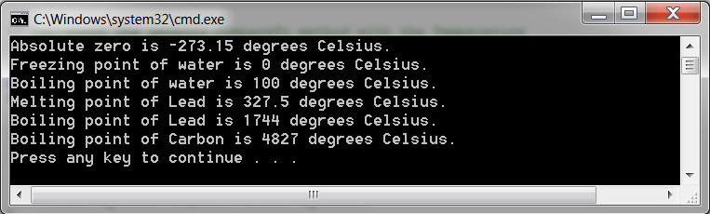
IComparable<T> Interface Example

Slide 37

IComparer Interface
If you want the List to Compare your object on a multiple Conditions, then create a Class that implements IComparer interface.
Implementing this Interface allows 2 independent objects to be compared on Multiple Conditions.
This leads to apply this logic on Sorting further with multiple conditions.
Example that Sorts on Name and if 2 Names are same, it Sorts by Address for those Names.
Notes:
Here 2 objects of the same type are compared, when equal you return 0, if x is greated than y, you return 1, else you return -1. Based on the return value, the Sort function of the IList interface would place the elements in the order.

Slide 38
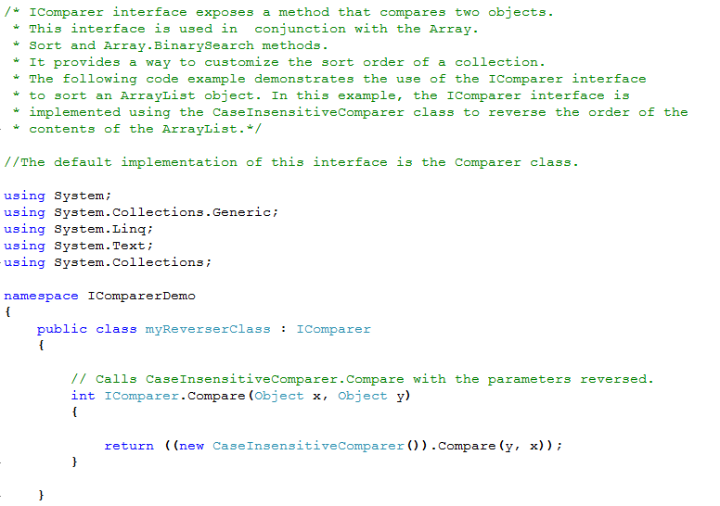
IComparer Interface Example
Notes:
Note: debug the code by pressing F11. You will get the idea how the CompareTo method is being called.

Slide 39
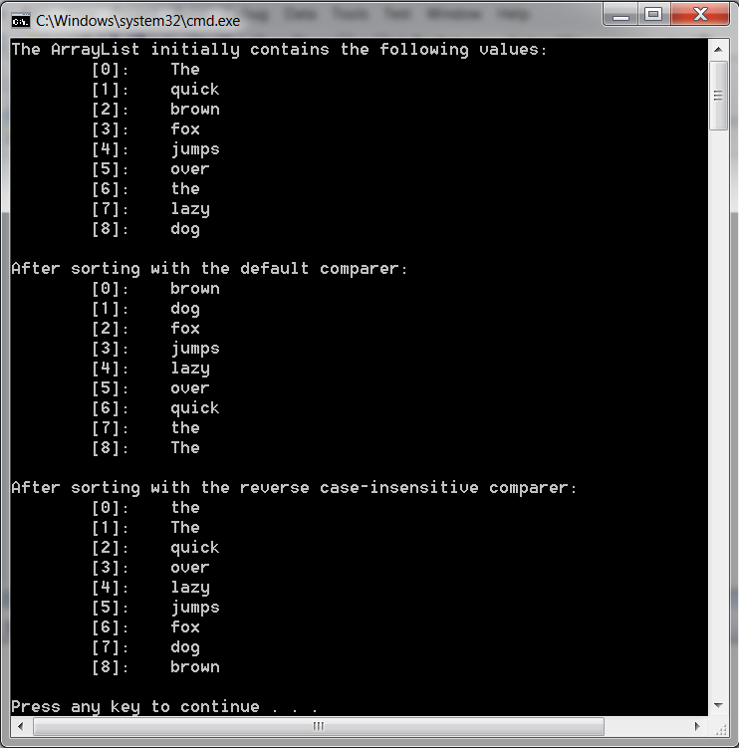
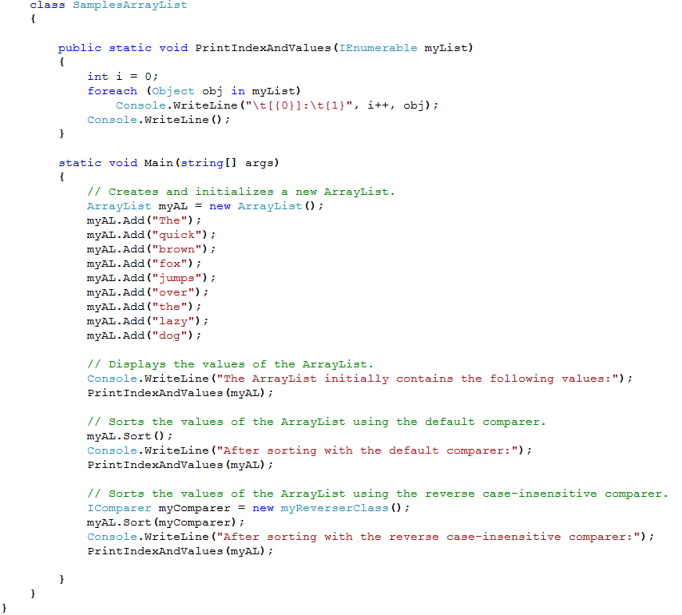
IComparer Interface Example

Slide 40
IComparable Vs. Icomparer: A Scenario and A Problem
1. Consider, you are using an instance of List<T> class to store some instances of a class object.
2. Now, you would like to sort the objects in the collection by calling Sort method of List<T> class.
3. At this point Sort method will sort the elements, present in the collection, by comparing characteristics of the instances.
4. So, you have to provide logic for comparing characteristics of those objects in a method that Sort method will call
5. Sort method is designed to call any of the following two interface methods:
a. CompareTo method of IComparable interface
b. Compare method of IComparer interface
You can use any of the two methods to provide comparison logic
Problem: Which one to use and when?

Slide 41
IComparable Vs. Icomparer: Lets Decide
Situtaion: You have access to source code of the class in question
Solution: Then implement IComparable interface and in turn its method CompareTo.
Situtaion: You DO NOT have access to source code of the class in question
Solution: create a separate class and implement IComparer interface and in turn its method Compare
Notes:
Situtaion: If you have access to source code of the class in question, then implement IComparable interface and in turn its method CompareTo
Solution: Implement IComparable interface in the business class. . Provide logic to compare characteristics of business object in CompareTo method.
Call Sort method on the collection object. Default implementation of Sort method automatically calls CompareTo method on current instance of business class in that collection and passes the next instance as argument to the method. Then with the logic provided by you in CompareTo method, all the objects, in this way, are compared and hence sorted
Situtaion: If you have DO NOT have access to source code of the class in question, then create a separate class and implement IComparer interface and in turn its method Compare
Solution: Create a separate class and implement IComparer interface. Provide logic to compare characteristics of business object in Compare method.
Pass reference of this class object to an overloaded version of Sort method. That overloaded implementation of Sort method calls the Compare method and passes two instances, current one and the next one, to Compare method as arguments. Then with the logic provided by you in Compare method, all the objects, in this way, are compared and hence sorted.

Slide 42
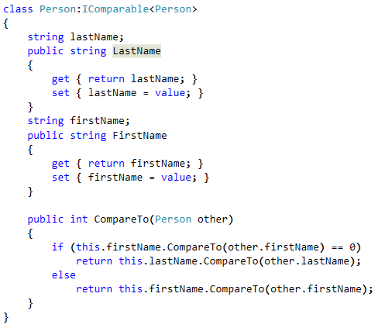
Comparison of Business Objects in a Collection using IComparable interface
Consider Person class source code is available with you. So, implement IComparable method’s CompareTo method of generic class IComparable interface.

Slide 43
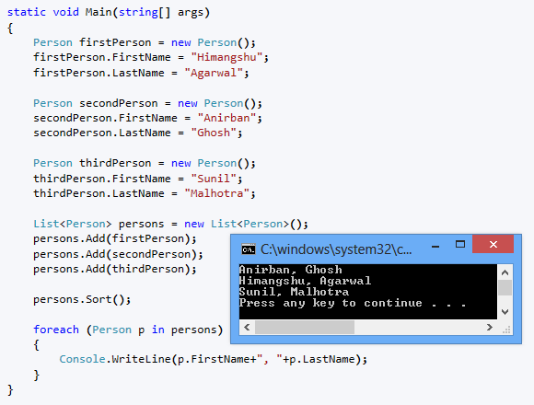
Comparison of Business Objects in a Collection using IComparable interface
When Sort method is called on the collection, it calls CompareTo method on current instance and sends the next instance as argument to the CompareTo method.
Characterestics of both the instances are compared and an integer value is returned to indicate the comparison result.
Accordingly all the elements in collection are sorted
Notes:
Note:
Implement IComparable interface in Person class, if you have the source code or Person class.
Explanation:
1. 3 objects of Person class are created.
2. They are added in the List<Person> object.
3. Sort method is called on the List<Person> object.
4. Sort method automatically calls the CompareTo method on the first instance of the person class present in the List and passes the second instance of Person class, present in the same List object, as argument to the CompareTo method
5. Now, CompareTo method compares between two person objects (this represents the current instance of Person class and other represents the next instance in the Lits) by comparing first name and last name.
6. If first name of both instances are same, then last name of both instances are compared

Slide 44
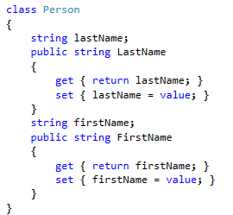
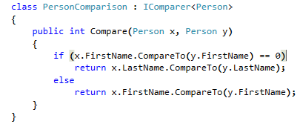
Comparison of Business Objects in a Collection using IComparer interface
Person class source code is not modified. Consider as if you do not have access to the source code.
So, you create another class PersonComparison and implement IComparer<Person> in it.

Slide 45
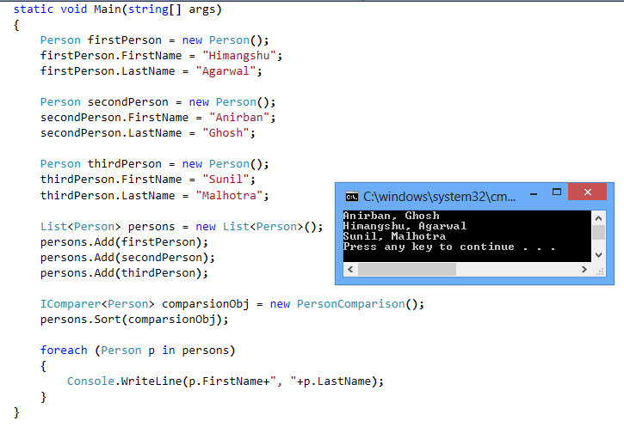
Comparison of Business Objects in a Collection using IComparer interface
Pass reference of the PersonComparison class to Sort methods, so that it knows where to find the comparison logic. When Sort method is called on the collection, it calls Compare and sends current and next instance as arguments to the method.
Characterestics of both the instances are compared and an integer value is returned to indicate the comparison result.
Accordingly all the elements in collection are sorted
Notes:
Note:
Implement IComparable interface in Person class, if you have the source code or Person class.
Explanation:
1. 3 objects of Person class are created.
2. They are added in the List<Person> object.
3. An instance of PersonComparison class is created and passed to Sort method as argument
3. Sort method is called on the List<Person> object.
4. Sort method automatically calls the Compare method and passes two instances of Person class, present in the same List object, as arguments to the Compare method
5. Now, Compare method compares between two person objects (this represents the current instance of Person class and other represents the next instance in the Lits) by comparing first name and last name.
6. If first name of both instances are same, then last name of both instances are compared

Slide 46
Reference
http://www.dotnet-tricks.com/Tutorial/csharp/U08E301212-Difference-between-Generics-and-Collections-with-example.html
http://www.dotnetperls.com/collections
http://msdn.microsoft.com/en-us/library/ybcx56wz.aspx
http://www.tutorialspoint.com/csharp/csharp_generics.htm
http://www.codeproject.com/Articles/37112/Generic-Collections-Interfaces-Classes
Notes:
Reference

